Slide 1
Housing Complaints
Task Force
11th January 2023

Slide 2
Agenda
Welcome & Introductions
Actions from Last Meeting – All/Kerry
Q3 figures, trends & preventative actions – James
Housing Ombudsman/Regulator update – David
TSM Q3 results – David
Preventative Actions for this quarter
Up Next…
AOB

Slide 3
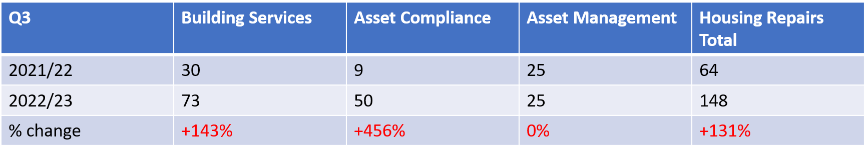
Housing Repair Complaints Q3
Response Times
The average complaint response time in Q3 was 13.5 working days, and we saw 57% of complaint responses breach their response deadline. This data is only for complaints responded to and not complaints that are still outstanding.
Themes & Trends
Lack of communication, delays to repair works, contractors/operatives turning up at times without scheduling or not the scheduled time.
The majority recent of complaints received are regarding boilers, roofing and damp and mould.
Notes:
Housing Repair Complaints are up 131% on Q3 last year, with all of these additional complaints being for Building Services and Asset Compliance.
Ask teams about successes.

Slide 4
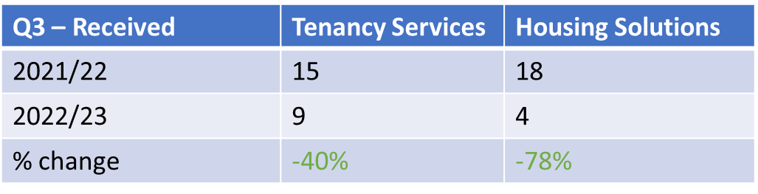
Tenancy Services & Housing Solutions Complaints Q3
Response Times
The average complaint response time in Q3 was 7.1 working days for tenancy services and 9.5 working days for Housing Solutions. Tenancy services saw 40% of complaints breach their response deadline, whilst housing solutions saw 25% breach.
Themes & Trends
Housing Solutions:
Lack of progress when going through the homelessness application
Lack of support whilst applying for household support grant
Tenancy Services:
Majority of complaints regarding a neighbour dispute, which could have been actioned outside of the complaints system
Both Tenancy Services and Housing Solutions receive complaints that are better placed being received outside of the complaints system, whether this be anti-social behaviour report forms or a Gateway to Homechoice banding appeal. In Q3 tenancy services closed 3 as outside of the complaints system and housing solutions closed 2.
Notes:
Ask teams about successes

Slide 5
Calendar Year Comparison
 | Building Services | Asset Management | Asset Compliance | Tenancy Services | Housing Solutions
2021 | 215 | 15 | 52 | 54 | 58
2022 | 286 | 100 | 67 | 40 | 37
% Change | +33% | 567% | 29% | -26% | -36%
Data between 1st January 2021 – 31st December 2021 compared to 1st January 2022 – 31st January 2022.

Slide 6
Stage Two Complaints & Housing Ombudsman Cases
Stage Two
There were 13 Stage Two complaints received for Housing in Q3. This is broken down between 11 for Housing Repairs, 2 for Tenancy Services, & 0 for Housing Solutions.
Ombudsman Cases
In Q3 there was one request for information from the Housing Ombudsman
Information was provided prior to Christmas however, the Councils’ have not yet heard back the timescale the Ombudsman are working to
The tenant complained that the Councils did not take enough preventative actions in regards to rodents entering the property and that we did not carry out repairs in a timely manner.
Notes:
Go through stage two complaints received for HR, TS and HS.
Housing Repairs
Brief overview of the Housing repairs complaints rather than a deep dive on each one. 4 complaints effectively roofing/GHB, where roofing repairs were reported a long time ago (some back to September 2021) and are still waiting on repairs to take place, these complaints also included issues such as damp and mould, insulation and cold properties. These complaints are primarily still ongoing with 2 overdue.
Other stage two complaints were about
how the tenant had reported issues with their boiler but the issues were not fixed correctly, leading to a higher usage of gas. Both of these complaints are still ongoing and the response is not due yet.
General delays to repairs or quality of repair work undertaken
Tenancy Services
One complaint was about how the Councils’ had promised bollards along the main road in Chelmondiston to prevent parking on grass verges. Through review of the complaint, BMSDC were waiting on information from SCC and the installation of the bollards would be progressed based on the information that SCC provided.
The second complaint was regarding an ongoing neighbour dispute, with the complainant feeling as though the tenancy services team had not acted in an appropriate manner and could have taken more steps to prevent the issues that had arisen. The complaint was not upheld as the officers involved had taken the appropriate steps to help deescalte the issues between the neighbours.
Housing Solutions
No stage two complaints received.

Slide 7
Housing Ombudsman Update
Complaint Handling Failure orders
Call for action on Record Keeping and Data Management
Submitted our response relating to the prevalence of damp and mould and our approach – Damp and Mould strategy.
Notes:
The Housing Ombudsman issued 45 complaint handling failure orders between July and September 2022, the highest number since they came into effect in January 2021. The majority of orders, 35, were issued while complaints were still within the landlord’s complaints procedure due to unreasonable delays in accepting or progressing a complaint through the process. Landlords handling of complaints also needs significant improvement with 66% of the complaints about complaint handling investigated by the Ombudsman upheld. What this means is that the majority of ombudsman upheld cases related to complaint handling rather than the original issue – some of the issues are around time taken to respond to a complaint for example.
This has been a consistent theme found by the Ombudsman in its casework with 67% of investigations upheld in 2021-22 involving poor records. more than two thirds of our determinations with a finding of maladministration have identified record keeping as an issue should be a cause of concern for landlords, particularly their governing bodies.

Slide 8
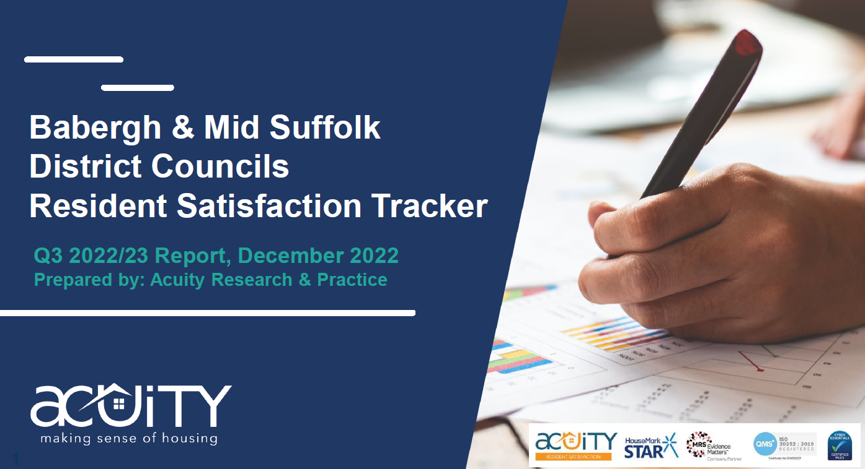
TSM – Q3 Results
Satisfaction with complaint handling down to 23% - only those who made a complaint are asked
  Response Times
  Satisfaction with outcomes
  Promises not kept resulting in repeat call backs and stage 2s

Slide 9
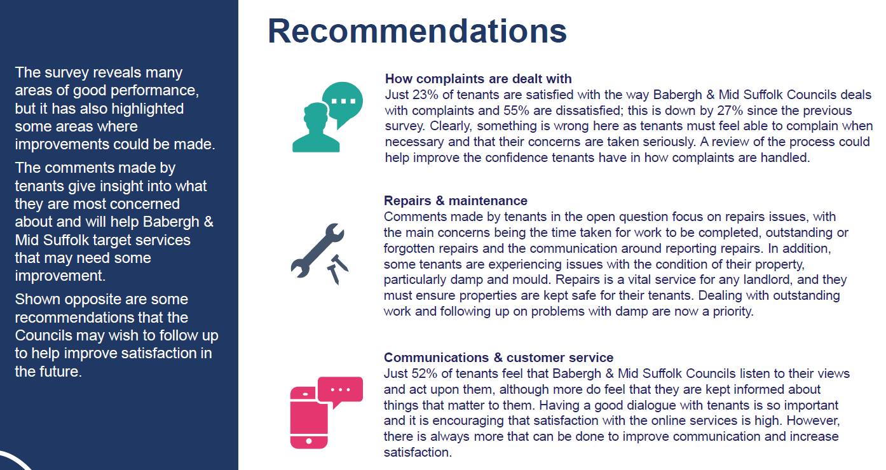

Slide 10

Preventative Actions Identified this Quarter

Slide 11
Up Next…
Complaint Handling Training
System changes – ready for regulation
Compensation Policy
Weekly complaints meetings to monitor performance
Final response audits

