Slide 1
Tenant Board
25th June 2025

Slide 2
Declarations of interest
We will be voting on the next two scrutiny project-
Review of the Customer Services phone lines/ messaging
AND
Ground Maintenance in housing communities (HRA Land)

Slide 3
Agenda
Declarations of interest (2 mins)
Action(s) from last meeting (3 mins)
Council Housing Assurance Report (10 mins)
Tenant Dashboards (15 mins)
Next scrutiny project (15 mins)
Grass cutting consultation- Liz and David (10 mins)
Any Other Business (5 mins)

Slide 4
Actions
GM to send:
Consumer standards training link
Tenant Engagement Review
Complaints Slides for feedback
Local Government Reform Consultation
Information on Interview help
Board to complete:
Consumer standards training
Review Complaint Themes

Slide 5
Housing Revenue Account action plan
Deborah Fenton- Director of Housing

Slide 6
HRA Finance Update
30th July 2025

Slide 7
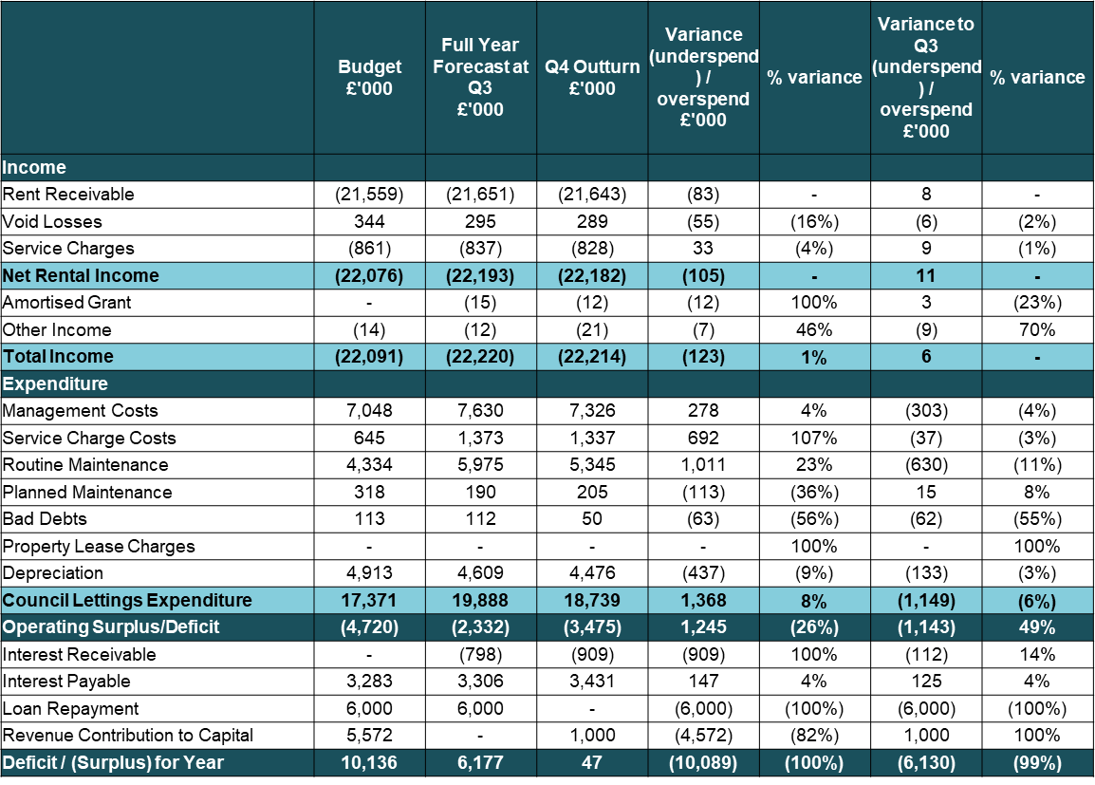
Babergh 2024/25 Outturn

Slide 8
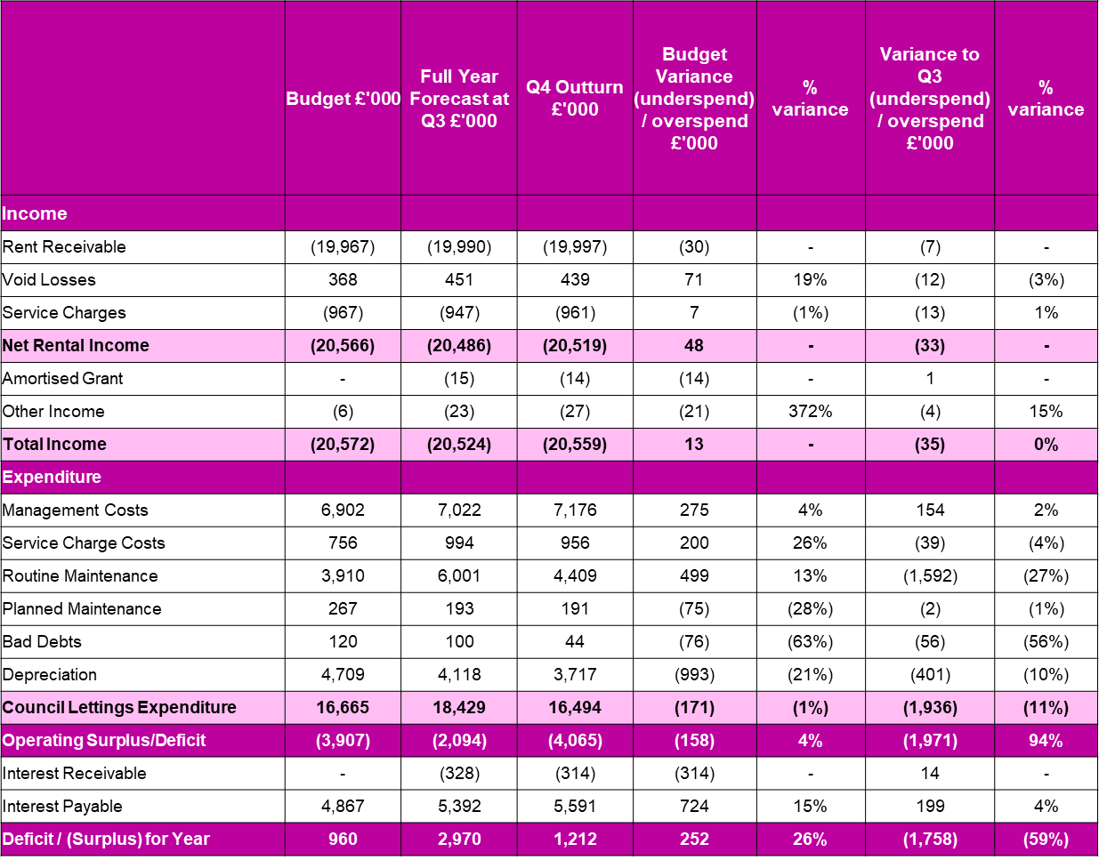
Mid Suffolk 2024/25 Outturn

Slide 9
Important Housing Changes: What Tenants Need to Know
Changes to Right to Buy
- Discounts for buying your council home are being reduced.
- Councils can now protect new homes from being sold for longer.
- This might make it harder or more expensive to buy your home.
- But it helps keep more homes available for people who need them.
Rent Increases: CPI + 1%
- From 2026, rents could continue go up each year by inflation (CPI) plus 1% for 10 years.
- This makes rent increases more predictable.
- However, if inflation is high, your rent could still rise quite a bit each year.
Rent Convergence
- If your rent is lower than the standard (called 'formula rent'),
- your landlord might increase it by an extra £1 or £2 per week until it catches up.
- This helps make rents fairer across similar homes.
- You might see slightly higher rent increases than others

Slide 10
What would you like to hear from us?

Slide 11
Council Housing Assurance Report
David White

Slide 12


Quarterly Landlord
Performance Reporting
  Property Compliance (Big 7+)
  Tenant Satisfaction Measures (TSMs)
  (Perception and Management)
  Stock Condition/Decency
  Asset Investment Programme Progress
  Evidence of Tenant Voice
  Consumer Regulation Assurance
  Repair Timeframes against policy
  Rent Collection as a % of the Debit
  Total Complaints responded to in line with Ombudsman guidelines
  Void times (key to key)
  Housing enquiry first time resolution

Slide 13







Governance Journey
GOVERNANCE ROUTE
Tenant Board
SLT
Overview & Scrutiny
Cabinet
Quarterly and raises concerns directs scrutiny into service performance
Quarterly along with Corporate Performance Report ahead of Cabinet
Twice a year to make recommendations before it goes to Cabinet
Receives the report from O&S with their recommendations a month later.
August Q1
November Q2
February Q3
April Q4
August Q1
November Q2
February Q3
April Q4
September Q4 & Q1
March Q2 & Q3
October Q4 & Q1
April Q2 & 3

Slide 14
Tenant Dashboards
Georgia Mecoy

Slide 15
Dashboards
Dashboards to be replaced by Housing Assurance Report
New void information sent from Jan- March
New measure on completing repairs on time- Emergency, Urgent and Routine
Repairs completing more jobs- working through Work in Progress
Complaints response times staying relatively high
Increase of ASB reports
ASB survey not showing reliable satisfaction for ASB as small number of people complete the survey

Slide 16
Next Scrutiny Project
Georgia Mecoy

Slide 17
Possible projects
August- September
Customer Services Mystery Shopping
October- February
Grounds Maintenance:
Low satisfaction score on TSM
Numerous complaints around the service
Community action days and Greater places fund used to improve Grounds Maintenance
VOTE NEEDED TO CONTINUE

Slide 18
Garden Consultation
David White and Liz Perryman

Slide 19
History
Public Realm have been cutting front gardens which we thought were communal land
Once this was identified, the housing team was told they needed to do a consultation by April 2025 to inform tenants that the grass cutting will stop.
By April 2025 the consultation had not been completed, however Public Realm were unaware of this and stopped the grass cutting service for these areas
Once they realised a consultation had not been completed, they reinstated the grass cutting with the expectation that a consultation was completed by April 2026.
Tenants from these areas received a letter to say that their grass cut had been stopped, however we have reinstated this for the time being until a consultation takes place.

Slide 20
Areas to be consulted on for grass cutting before April 2026
Samford Close, Holbrook
Tayler Close, Hadleigh
Stutton Close, Stutton
Jervis Close, Holbrook

Slide 21
Any Other Business
Complaints Scrutiny workshops
14th July, 18:00- 20:00, Online
17th July, 10:00-15:00, Copdock Village Hall
TSM target setting workshop
8th July, 10:00- 12:00, Endeavour House
Thank you

